Slide 1
MENTAL HEALTH IN THE TECH INDUSTRY

Slide 2
questions
How is mental health in tech affected by gender
How is mental health in tech affected by employer size
How is mental health in tech affected age
How is mental health affected by around the world

Slide 3
GENDER

Slide 4
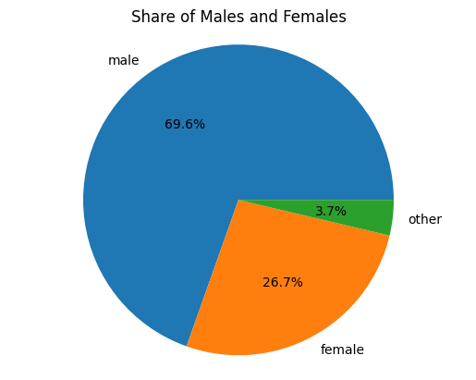
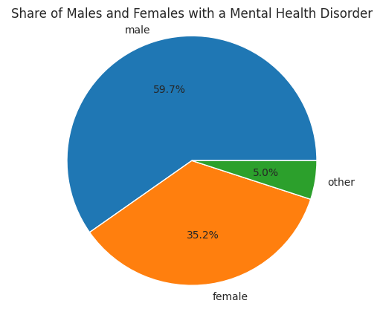
GENDER employer SIZE VS. GENDER mental health disorders

Slide 5
EMPLOYER SIZE

Slide 6
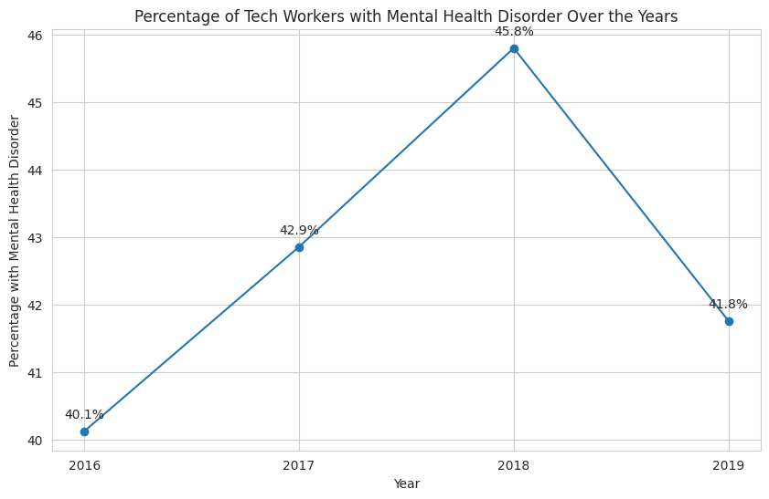

Slide 7
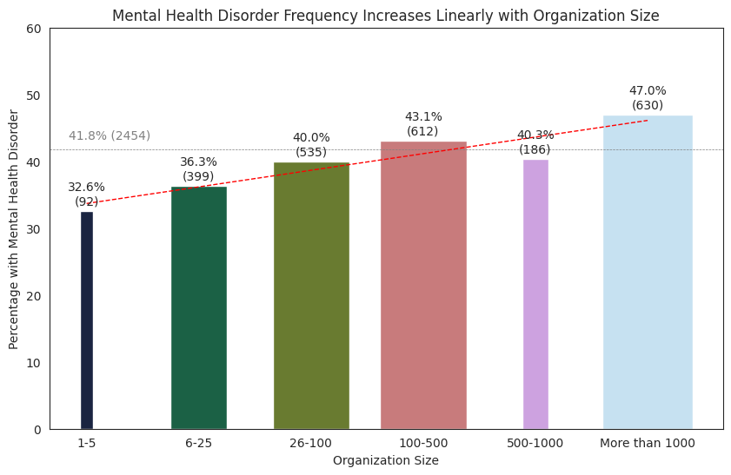

Slide 8
AGE

Slide 9
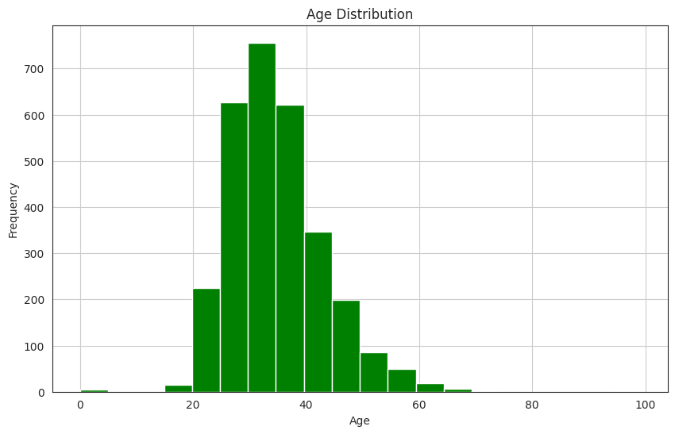

Slide 10
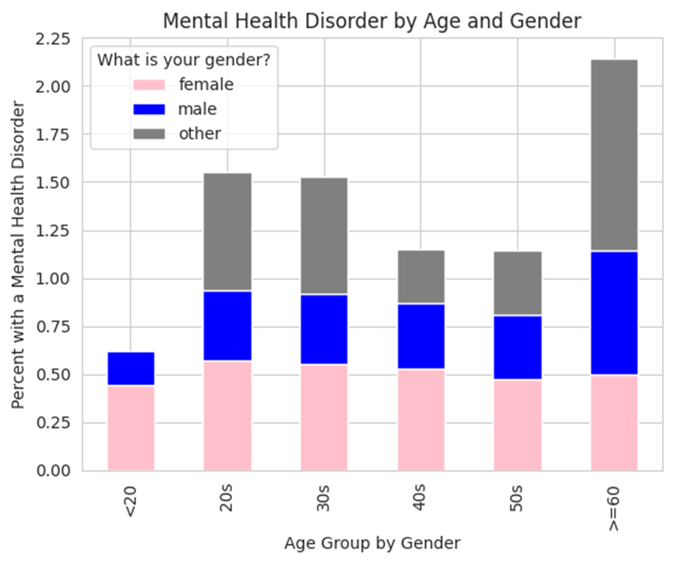
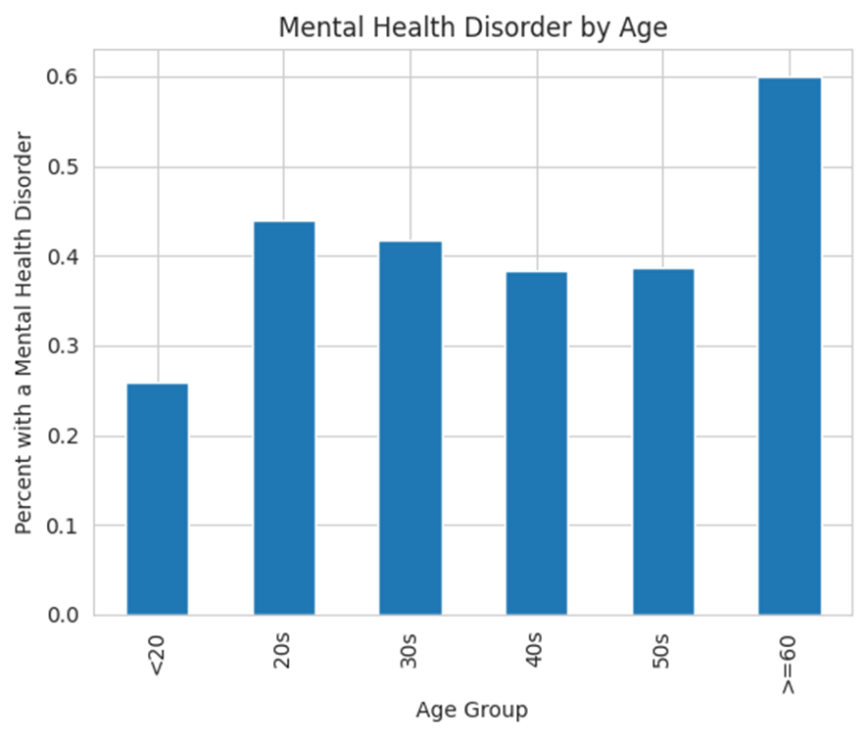
MENTAL HEALTH DISORDER BY AGE VS. AGE BY GENDER

Slide 11
ACROSS THE WOLRD

Slide 12
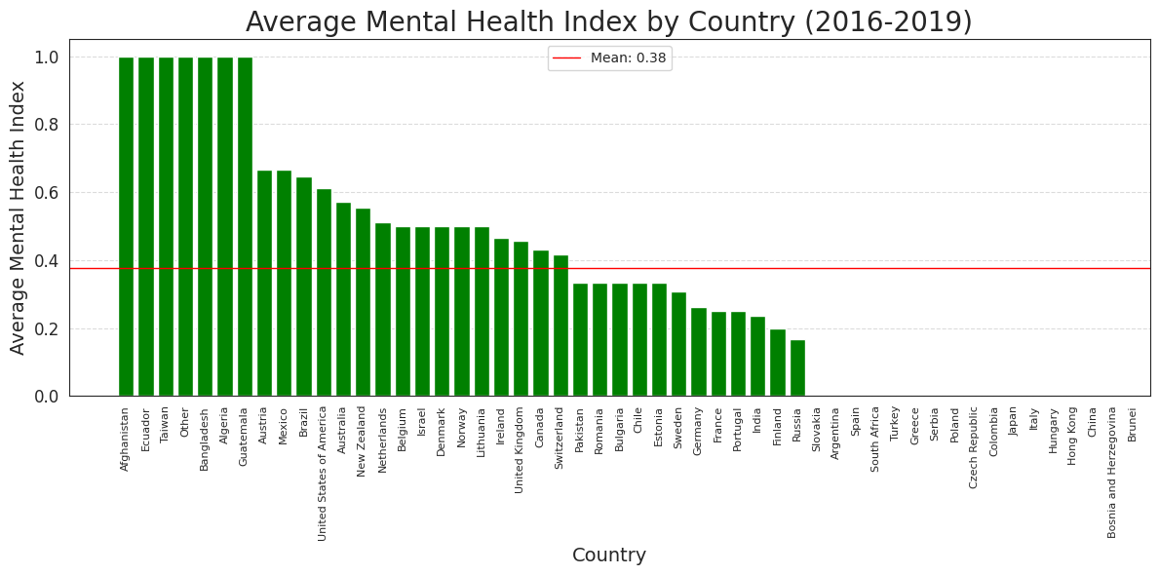

Slide 13
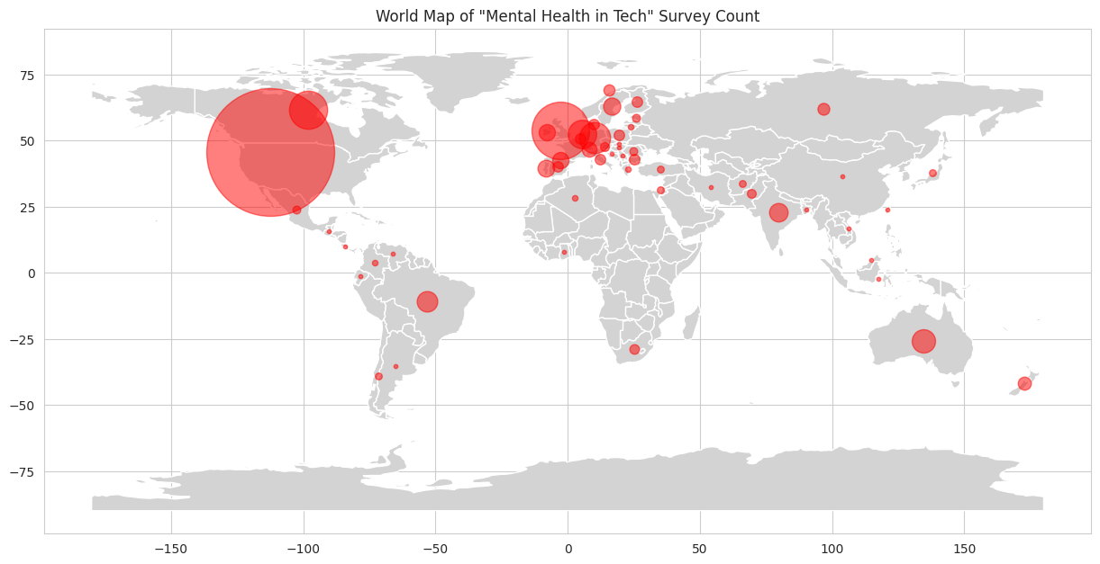

Slide 14
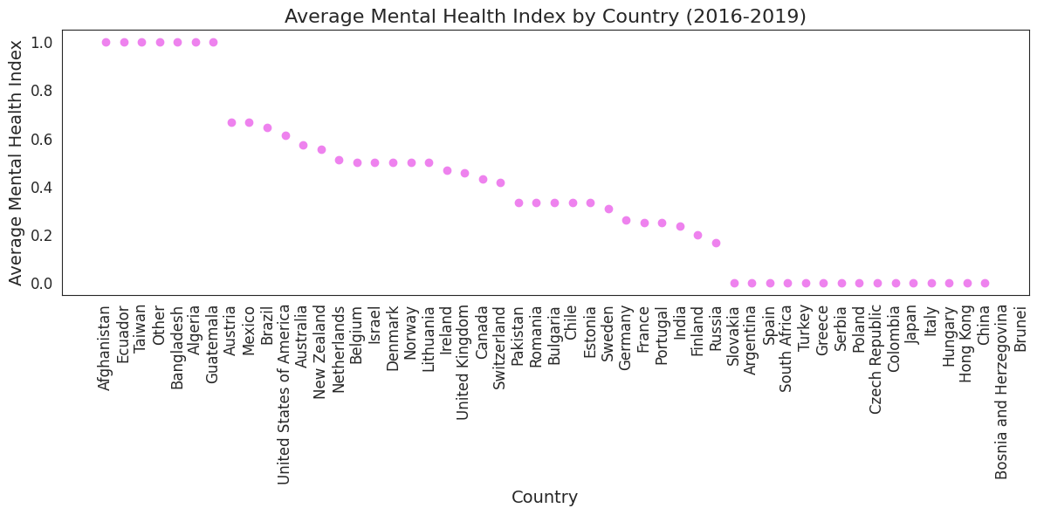

Slide 15
Final thoughts
High-pressure environments
Culture of work
Isolation and loneliness
Stigma around mental health
Efforts to address mental health
Remote work challenges

Slide 16

Thank you
Team 4
Tyler Potts
Thierno Diallo
Jeremiah Mergenthaler
Kayli Smith
Sylvia Turner

